Slide 1

Office 365 Overview

Slide 2
Introduction to OFFICE 365
Office 365 is a suite of services offered by Microsoft.
Office 365 is the same Office you already know and use every day, but with a slightly different interface and many more features.
Office 365 is powered by the cloud, so you can access your applications and files from virtually anywhere (desktops, tablets, mobile phones), and they're always up to date.

Slide 3
PRESENTATION Overview
This presentation will cover new features available in the Outlook Web App (OWA) and Microsoft Outlook 2013. Click on any of the links below to browse to the topic of your choice (note: you must be in “Slide Show” or “Reading View” mode for the links to be valid).
Outlook Web App (OWA) | Microsoft Outlook 2013
Change your password Manage e-mails Automatic replies E-mail rules Manage your calendar View your calendar Manage multiple calendars Create a calendar event Manage your contacts Create a contact Create a personal or shared group Manage your tasks What are tasks? Create a task Miscellaneous Change the theme of your OWA Add a photo of yourself to your account Add an e-mail signature Sign out of your OWA | Mail Mail overview Customize your view Filter e-mail Calendar Calendar overview Customize your calendar Add calendar permissions Share your calendar Access e-mail on your phone or tablet

Slide 4
Outlook Web App
The Outlook Web App (OWA) allows you to check and manage your Outlook from your Web browser, whether you’re inside or outside of the office.
Any changes you make in your OWA will be synced to your Outlook application, and vice versa.
To access your OWA, visit https://outlook.office365.com and log in using your credentials.

Slide 5
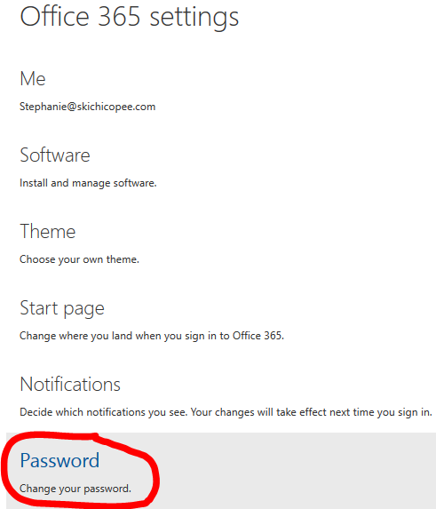
Change your password
Change your password by clicking on the “gear” icon in your OWA > Office 365 settings > Password.
Note: When you go to “Office 365 settings”, you are no longer in the OWA but rather in the “Office Portal”. Click on the “Outlook” tab at the top to go back to your OWA.

Slide 6
Managing your e-mail

Slide 7
Create e-mail auto-replies
From your OWA, click on the “gear” icon in the top right corner, and select “Options”.
Under the “Mail” > “Automatic processing” headings, select “Automatic replies”.
You can customize your auto-reply so that it sends to users only in your contact list, within your organization, outside of your organization, or to everyone.

Slide 8
What are e-mail rules?
Rules allow you to automatically sort your incoming and outgoing e-mails into folders. You can use rules to:
Sort incoming messages based on sender and subject
Sort sent messages into folders
Create desktop alerts
Create and filter messages with high importance
Add exceptions to rules
Flag messages for follow-up
Filter flagged messages
Add sounds
And more
From your OWA, you can review what a rule does, turn rules on or off, create new rules, edit existing rules, or delete rules.

Slide 9
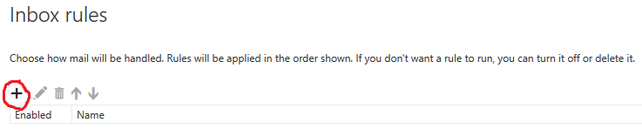
Create AN E-mail Rule
From your OWA, click on the “gear” icon in the top right corner, and select “Options”.
Under Mail > Automatic Processing, select “Inbox rules”.
Click on the “+” sign to create a new rule.
Give your rule a relevant name, and follow the prompts to set up your rule according to the conditions you specify.
For additional help in creating rules in Outlook, please refer to our video tutorial: https://www.youtube.com/watch?v=wUqyZ3YT5Gc

Slide 10
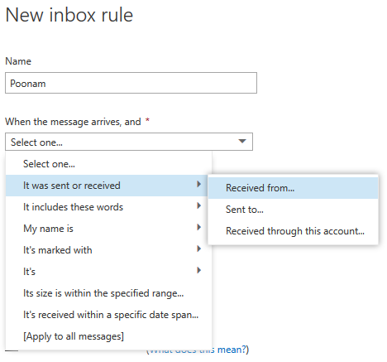
Create AN E-mail Rule - example
Let’s create a rule that automatically moves incoming e-mails from Poonam to the “Poonam” folder, unless they’re marked with high importance (these will be sent to our regular inbox).
From the “Inbox rules” page, click on the “+” sign to create a new rule.
Name the rule “Poonam”.
When the message arrives, select “It was sent or received” > “Received from”
From our contact list, click on the “+” sign beside Poonam Kaur’s name, then click “OK” at the top.
Under “Do the following”, click “Move, copy or delete” > “Move the message to folder”
Select the “Poonam” folder in our inbox (if necessary, expand the inbox by clicking on the arrow to the left).
Under “Except if”, click “Add exception”.
Select “It’s marked with” > “An importance”.
Select “High importance”.
Ensure that the “Stop processing more rules” option is selected.
With this option on, when an incoming e-mail meets the criteria for more than one rule, only the first rule will be applied. Without this setting, all rules that the message meets the criteria for are applied.
Click “OK” at the top.

Slide 11
Managing your calendar

Slide 12
Manage your calendar
You can use your calendar to create and track appointments, and create reminders.
Appointments can be single occurrences or repeated occurrences (e.g., team meeting every Friday).
You can create multiple calendars, link to other people’s calendars, and share your calendar with other people in your organization.

Slide 13
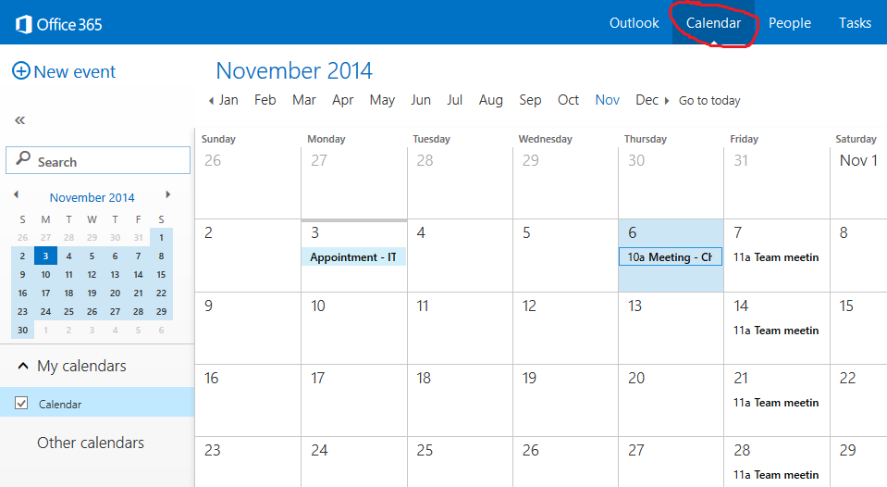
VIEW your calendar
From your OWA, click on the “Calendar” heading at the top of the screen.

Slide 14
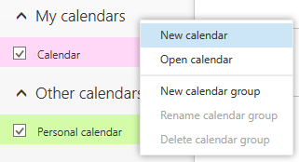
Managing multiple calendars
You can create other calendars, such as one to track personal appointments.
Right-click on “My calendars” or “Other calendars” to create a new calendar.
You can view more than one calendar at a time by selecting the check-boxes beside the calendar(s) you wish to view. If you select multiple calendars to display, they’ll be merged into a single view with each calendar given a different colour.
Change the colour of a calendar by right-clicking on it, and select “Colour”.

Slide 15
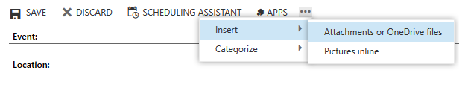
Create a calendar event
From your calendar, right-click on the date you wish to create an event and select “New”. Alternatively, click “+ New Event” in the top left corner.
Complete the fields as indicated.
To turn a calendar item into an invitation (e.g., for a meeting), enter the names of people you want to invite in the “Attendees” field. Attendees will receive an e-mail invitation to your event.
To create a recurring event (such as a team meeting), select the recurrence under the “Repeat” menu.
Attach files to your appointment by clicking on the “…” button at the top. Select “Insert” > “Attachments or OneDrive files”, then browse to the file you wish to attach.

Slide 16
Managing your contact list

Slide 17
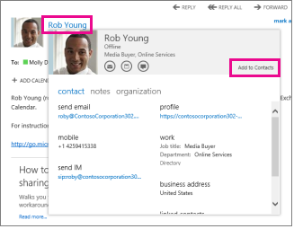
Manage your contacts
View and manage your contacts from the “People” tab at the top.
From here, you can add contacts by clicking “+ New” at the top left.
You can also add contacts from an e-mail message to your contact list.
Select the name to see the contact card.
Click “Add to Contacts”.
Your “Directory” will show you your list of contacts at your organization.

Slide 18
Create and manage a group
You can create two types of groups in OWA: personal groups and shared groups.
Personal groups are stored in your Contacts folder and can contain entries from your personal Contacts and from your organization’s address book.
Shared groups are called “Distribution groups” and they appear in your organization’s address book.
You can create, join, or leave distribution groups that are in your company’s address book.
Example: You may have a “Guest Services” group, whereby e-mails sent to Guest Services get e-mailed to only members within the group.

Slide 19
Managing your tasks

Slide 20
What are tasks?
You can use tasks to keep track of things that you need to do but don’t necessarily want to put on your calendar.
From the “Tasks” panel, you’ll see:
Tasks that you create
Tasks that are sent to you
Messages you’ve flagged.

Slide 21
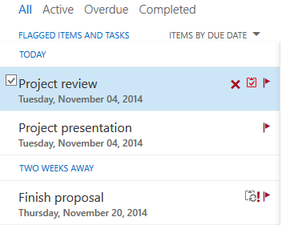
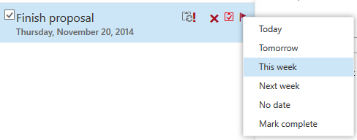
Manage your tasks
View and manage your tasks from the “Tasks” heading in your OWA.
Create a task by clicking “+ New task” in the top left corner.
E-mails you flag will automatically be added to your tasks list.
View your active, overdue and completed tasks from the task pane.
Right-click on the “flag” button beside a task to change the deadline or mark it complete.
Create reminders for tasks when you create them, or by clicking on an existing one to update the task information.

Slide 22
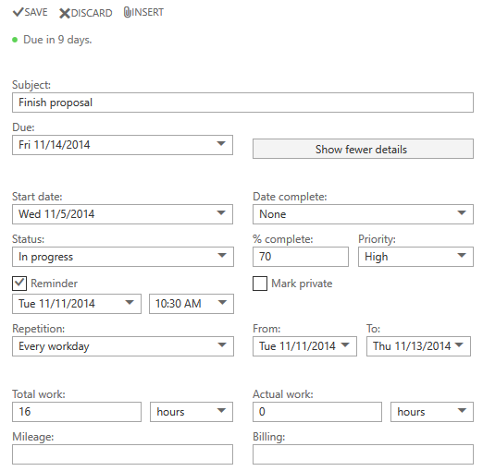
Create a task - example

Slide 23
Miscellaneous
Change the theme on your OWA by clicking on the “gear” icon > Change theme. You may have to refresh the page for your new theme to apply.
Add a photo of yourself to your account by clicking on your profile image and select “Change”.
Update your e-mail signature by clicking on the “gear” icon > Options > Layout > E-mail signature.
To sign out of your OWA, click on your profile image, and select “Sign out”.

Slide 24
Microsoft outlook 2013

Slide 25
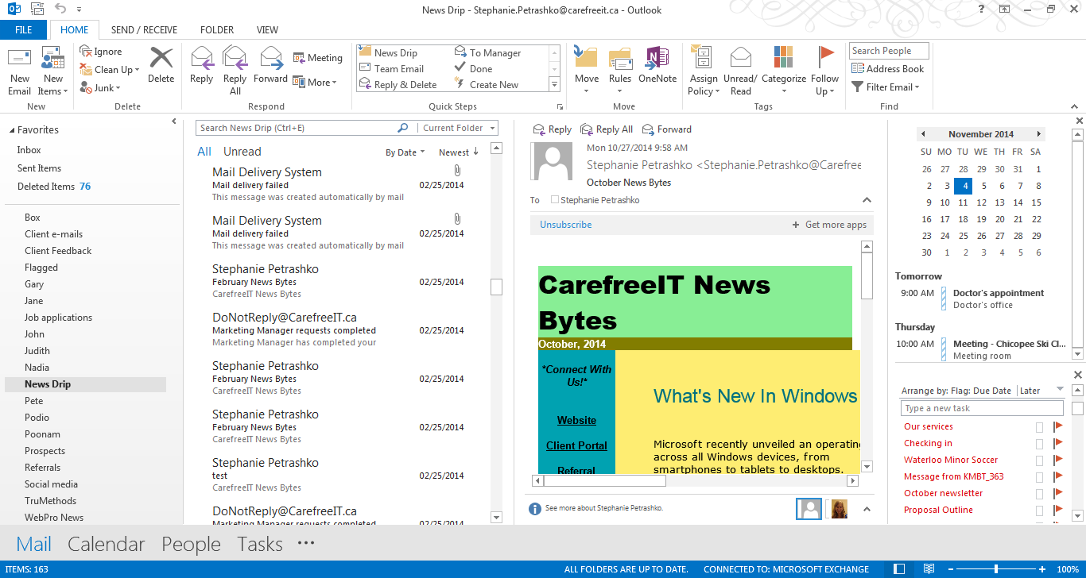
Microsoft Outlook 2013 - Mail

Slide 26
Microsoft Outlook 2013 - mail
Create appointments, tasks, contacts & more
Flag items & add reminders
Customize your Outlook view
Filter e-mail
Manage rules
Calendar & appointments
Inbox subfolders
Task list
Manage mail, calendar, contacts & tasks

Slide 27
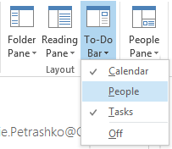
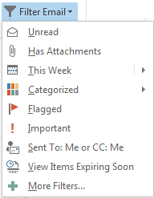
Microsoft Outlook 2013
To customize the view of your Outlook, select the “View” tab at the top.
To display your calendar, people and/or tasks, click on the “To-Do Bar” and select the options you wish to appear.
Filter e-mail by date, importance, attachments and more using the “Filter E-mail” option on the ribbon bar (“Home” tab).

Slide 28
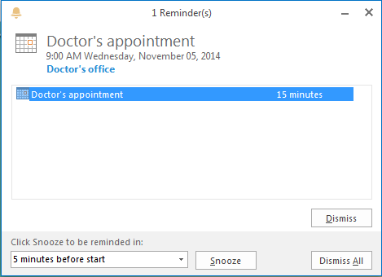
Microsoft Outlook 2013
When you create reminders for items, the reminder will appear in the form of a pop-up on your desktop.

Slide 29
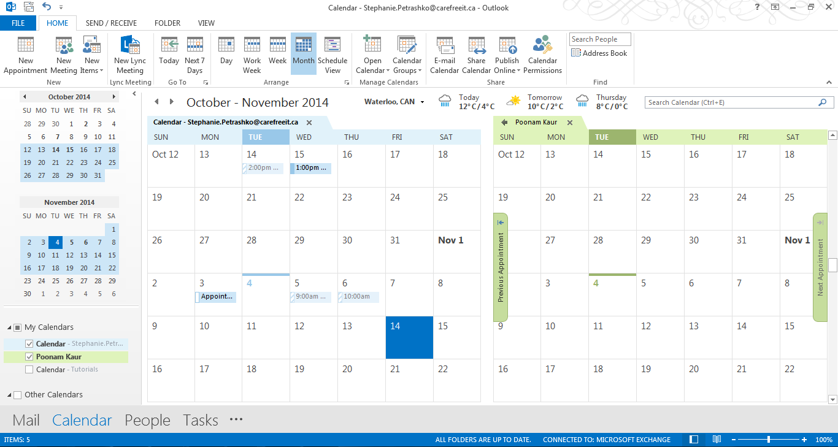
Microsoft Outlook 2013 – Calendar

Slide 30
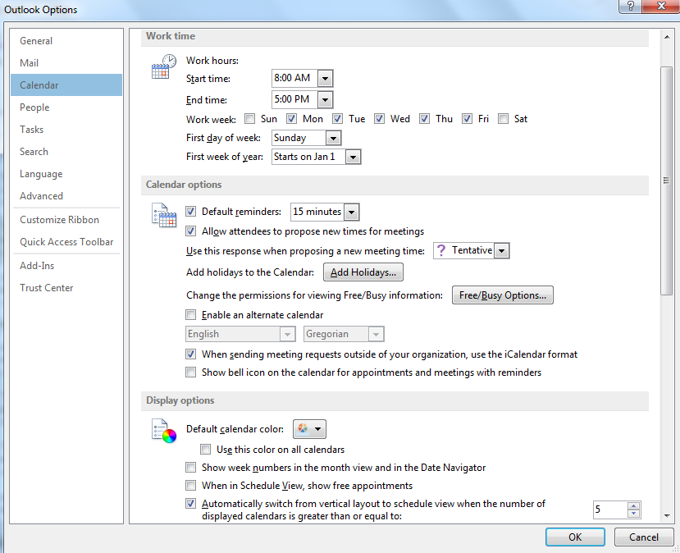
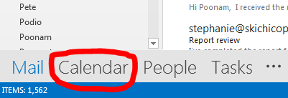
Microsoft Outlook 2013 – Calendar
View your calendar by selecting the “Calendar” tab at the bottom of the screen.
Customize your calendar by going to File > Options > Calendar. From here, you can:
Customize the days of the week that appear on your calendar.
Create reminders for calendar events.
Add holidays to the calendar
Change the calendar colours and general display.
Add or change a time zone.
Add/remove the weather display, & show temperature in Fahrenheit/Celsius.
And more.

Slide 31
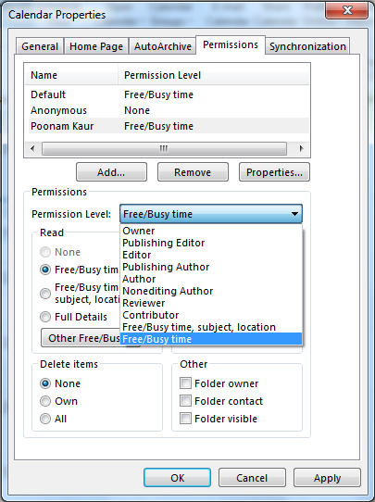
Add Calendar Permissions
From your Outlook application, select the “Calendar” tab.
On the top ribbon, select “Calendar permissions” > “Add”.
Select the user you want to give permissions to.
Choose the permission level from the drop down.
Choose the level of access you wish to provide users.

Slide 32
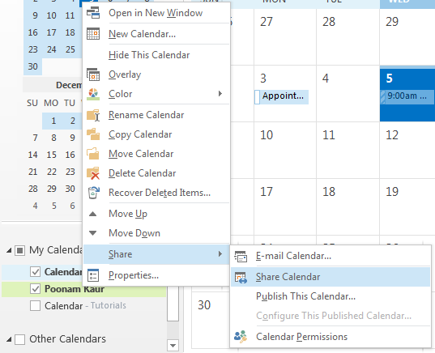
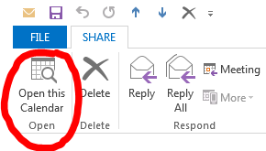
Share your Calendar
From Outlook, select the “Calendar” tab.
Right-click on the calendar you wish to share, and select “Share” > “Share Calendar”.
Enter the person you wish to share with, along with an optional message. Click “Send”.
The recipient will need to click “Open this Calendar” for the calendar to appear in his/her calendar tab.

Slide 33
Access e-mail on your phone or tablet
If you wish to receive e-mail on your smartphone or tablet, please inform an on-site technician and he/she will be able to help you.
Otherwise, please contact our Help Desk at help@carefreeit.ca or 519-883-7815 ext. 2 and a technician will be happy to assist you.

Slide 34
Please contact our help desk at help@carefreeit.ca or 519-883-7815 ext. 2.
Questions?

